Slide 1

UPDATE MESSAGE
Dear Exhibitor,
This update contains important logistical information concerning the EuroPRevent Congress 2012.
Therefore, please ensure this message and the Industry Guidelines are distributed to all your staff and agencies involved in this Congress.
All the stand service order forms are available on the following site:
http://www.escexhibition.org/EuroPRevent2012/default.aspx

Slide 2
UPDATE MESSAGE
Contents:
Access
Build up and Break down
Security
Delivery Address and Storage
Stand Service Orders
Exhibition Opening Hours
Exhibitors Registration
Badge Readers
Stand Design and Activities Approval
Important Reminders
Future ESC Congresses

Slide 3
UPDATE MESSAGE
1. Access
EuroPRevent 2012 will be held in the Convention Center of Dublin – CCD, Ireland.
The exhibition is located on the ground floor of the CCD building – in the Forum Hall.
For more details, see the Access plan on:
http://www.escexhibition.org/EuroPRevent2012/default.aspx
Parking:
Always park your vehicle in the allotted space. Note that parking is not allowed in front of doors or on ramps. Information about truck and car parking is available on:
http://www.escexhibition.org/EuroPRevent2012

Slide 4
UPDATE MESSAGE
2. Build up and Break Down
Cars and forklifts cannot be driven into the exhibition hall. Always park your vehicle in the allotted space outside. Space is limited – as soon as you have unloaded, please move your vehicle away from the unloading area. On arrival, drivers should report to uniformed staff from FAIREXX, the Official ESC Logistics Provider, to obtain a Working Pass. This pass carries the name of the individual, company and booth number. It needs to be carried at all times during the build up/break down.
Exhibition Build Up:
- Wednesday 02 May 09:00 – 18:00 Exhibition Build-Up
- Thursday 3 May 08:00 – 09:00 Stand decoration only
Dismantling:
- Saturday 5 May 14:00 – 24:00 Dismantling

Slide 5
UPDATE MESSAGE
Freight Free Aisles
Island booths are separated the width of an aisle from all neighbouring exhibits, demonstration areas may not be set on the aisle line of the exhibit; space must be left within the exhibit area to absorb the spectators.
Should the spectators interfere with the normal traffic flow in the aisle or overflow into neighbouring exhibits, the presentation must be limited or stopped immediately.
No objects, including signs or advertisements, may project into the visitor’s aisles.

Slide 6
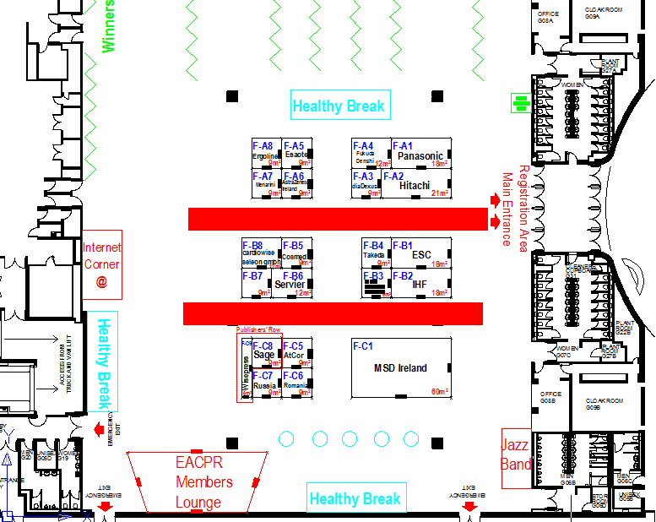
UPDATE MESSAGE
Freight Free Aisles

Slide 7
UPDATE MESSAGE
3. Security
The ESC undertakes the general surveillance service of the Building, both by day and at night.
Each Exhibitor is responsible for the security of their stand and exhibit. Exhibitors are recommended to pay close attention to the exhibits during the stand construction and dismantling periods. We strongly urge exhibitors to secure their stand against theft or damage. Valuable objects, which may easily be removed, should be locked away during the night or whenever the stand is left unattended. Particular attention should be paid to goods awaiting collection at the end of the Congress. The ESC accepts no responsibility for goods stolen from exhibits.
Security services can be ordered from the congress centre.
The ESC may refuse or expel any person whose behaviour or clothing is considered incompatible with the image of EuroPRevent 2012, or who refuses to comply with the local safety rules.

Slide 8
UPDATE MESSAGE
4. Delivery Address and Storage
Official Forwarder and Lifter for EuroPRevent 2012:
FAIREXX GmbH
Contact: Stefan Grunwaldt
TEL: +49 304 403 4713
FAX: +49 304 403 4779
email : stefan.grunwaldt@fairexx.com
To ensure the receipt and management of your shipment, please fax a full pre-advice to FAIREXX LOGISTICS Fax: +49 304 403 4779 attn. Mr. Stefan Guenther.
For more information, download the FAIREXX Manual from:
http://www.escexhibition.org/EuroPRevent2012/Stand%20Services%20Download%20Area/Fairexx%20Manual.pdf

Slide 9
UPDATE MESSAGE
Storage:
No refuse (e.g. empty cartons, crates or shipping/packing materials) may be left behind on your booth or in the aisles.
If any exhibitor or contractor(s) leaves such materials behind, the costs of removing will be charged to the exhibitor.
Please contact the Official Forwarder and Lifter (Fairexx) for handling and storage of your empty crates and other packing material during the Congress.
Airfreight Shipment (Warehouse Address):.
Should arrive at Munich International airport (MUC) no later than 20 April 2012 addressed as follows :
Consignee Adress: MULTILOGISTICS GmbH
Modul D / 3rd Floor
Suedallee – Cargoterminal
DE- 85356 Munich-Airport / Germany
Notify: FAIREXX - Logisitics for Exhibitions GmbH
Europrevent 2012 / Exhibitors name, Hall + Stand No.
Pre-advices: For your Airfreight Shipments, send to Fairexx in advance
by fax: +49 304 403 4779 or by email to stefan.grunwaldt@fairexx.com
o 1 Copy of Airwaybill / Flight details
o 1 Copy of commercial invoice / packing list

Slide 10
UPDATE MESSAGE
Full / Half Trailer Loads – Direct deliveries to the venue:
Should arrive directly at CCD (The Convention Centre Dublin), in accordance with the official build-up schedule and slot number given by Fairexx.
For deliveries of semi & full loads during build up, make sure you send a timeslot request form to Fairexx to schedule your truck access. Trucks will be refused access if not on the Fairexx schedule.
Venue Address: THE CONVENTION CENTRE DUBLIN
c/o FAIREXX Logistics for Exhibitions GmbH
East Access Road - Spencer Dock
North Wall Quay - IRL- Dublin 1 - IRELAND
Notify: EuroPRevent 2012/Exhibitors Name, Hall & Stand Number
Pre-advices: For your Roadcargo Shipments, please send to Fairexx in advance by fax: +49 304 403 4779 or by email to stefan.grunwaldt@fairexx.com
o Trucking details (Truck no., haulier, ETA)
o Copy of invoice / packing list

Slide 11
UPDATE MESSAGE
5. Stand Service Orders
For information regarding the Building or to plan a visit, please contact:
Ms. Rebecca Walsh
Tel : +353 1 856 0000 Email: rebecca.walsh@theccd.ie
For information regarding technical aspects of the exhibition, please contact:
Mr. Edwin Whelan
Tel: +353 181 845 71
Email: edwin.whelan@theccd.ie
Requests for:
Stand cleaning,
Internet, phone and fax connections,
Catering,
Hostesses and security,
Should be made online via the Convention Centre Dublin – CCD web site: http://www.escexhibition.org/EuroPRevent2012/Stand%20Services%20Download%20Area/Online%20Stand%20Services%20Order.pdf

Slide 12
UPDATE MESSAGE
6. Exhibition Opening Hours
Exhibition Opening Hours:
Thursday 3 May
09:00 – 20:00 Exhibition OPEN
18:00 – 19:00 Opening Ceremony
19:00 – 20:00 Opening Cocktail in the Exhibition Area
Friday 4 May
09:00 – 18:00 Exhibition OPEN
Saturday 5 May
09:00 – 14:00 Exhibition OPEN
All exhibiting staff must wear an Official EuroPRevent badge at all times within the
venue.

Slide 13
UPDATE MESSAGE
7. Exhibitors Registration
Exhibitors are entitled to a certain number of free badges. The number of free badges for each Exhibitor will be determined according to the floor space allocated as shown below. Please note that company names other than those of listed exhibiting companies are not permitted.
Stand size between Number of Free Badges
9 and 49m² 8
50 and 99m² 16
100m²+ 24
Exhibitor badges are reserved for staff working directly in the organisation and management of exhibits, satellite symposia and sponsored activities.
Bearers are subject to the restrictions contained within these Guidelines.
Exhibitor badges do not give access to the EuroPRevent Scientific Sessions.

Slide 14
UPDTAE MESSAGE
Exhibitors Registration Opening Hours
Wednesday 2 May 15:00 – 18:00
Thursday 3 May 08:00 – 18:00
Friday 4 May 08:30 – 18:00
Saturday 5 May 08:30 – 15:00
Exhibitor Badge Orders
You have the option to choose how your free badges are inscribed. Indicate when you send the exhibitor badge application form by email, the number of company-only badges you wish to receive and the number of individual badges you wish to receive (please indicate each person’s name).
Additional Exhibitor Badges
If the number of free Exhibitor badges is insufficient, extra badges may be purchased at a price of €100.00 per badge. VAT is not applicable.
Working Passes
In the interest of security, only those individuals directly responsible for the erection and dismantling of the stands will be permitted in the Exhibition area during stand construction and dismantling times. To this end, Working Passes will be given out at the Exhibitor Registration desk and at the lorry unloading area during stand construction and dismantling times. Registered Exhibitors may also gain entrance to the Exhibition hall during installation and dismantling times by showing their Exhibitor badge at the entrances.

Slide 15
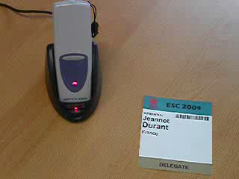
UPDATE MESSAGE
8. Badge Readers
Recording a prospective customer’s information can be done by using one of the EuroPRevent 2012 Badge Readers. There are two models available:
Classic Badge Reader:
http://www.escexhibition.org/EuroPRevent2012/Badge%20Reader%20Library/key4lead%20Classic%20Badge%20Reader.pdf
New Advanced Badge Reader:
http://www.escexhibition.org/EuroPRevent2012/Badge%20Reader%20Library/key4lead%20Advanced%20Badge%20Reader.pdf

Slide 16
UPDATE MESSAGE
9. Stand Design and Activities Approval
Stand Drawings and Designs
- Exhibits must be displayed on stands for the entire duration of the exhibition; display of products other than those listed in the application is not permitted.
- EuroPRevent 2012 Secretariat is entitled to have exhibits removed from the stand if their display runs counter to the principles of fair competition or does not comply with the display programme.
- Details of prices, given in the form of signboards or stand lettering, are not permitted, nor are references to sales of products already affected or details of suppliers and customers.
Stand Giveaways and Activities
Please inform the ESC of your planned Stand Activity and Giveaways by sending the Stand Activity form available on:
http://www.escexhibition.org/EuroPRevent2012
Please note that stand activities should adhere to the rules stated in the Guidelines

Slide 17
UPDATE MESSAGE
10. Important Reminders
Access
The Congress is only accessible to certified healthcare professionals, associated press, industry representatives and other stakeholders in the science, management and prevention of cardiovascular disease.
Payment
Please note that payment for stand rental must be made in full before the event.
Smoking
Smoking is strictly forbidden anywhere in the building.
Alcohol
Exhibitors must not serve any alcoholic beverages from the stand.

Slide 18
UPDATE MESSAGE
Catering
Please note that it is forbidden to take food and/or drinks into the building or to keep
them on the premises unless ordered through the official caterer:
http://www.escexhibition.org/EuroPRevent2012/Stand%20Services%20Download%20Area/Online%20Stand%20Services%20Order.pdf
Distribution of promotional material, directions etc. from the stand
CCD Services has the exclusive right to serve food and beverages within the exhibition area. Prior permission shall be obtained from ESC for any distribution of food and beverage samples. The CCD Services must make sure that the rules and regulations laid down by the Irish authorities are observed. However, Exhibitors are allowed to establish serving areas at their stand, but only after approval by and according to specifications laid down by the CCD Services.
Exhibitors are allowed to hand out food and beverage samples of their own products under conditions. Under no circumstances will the exhibitors be allowed to sell food or beverages from their stand. All food & drink offered in the exhibition must be arranged via the official caterer.
Orders should be made via the CCD online services.

Slide 19
UPDATE MESSAGE
11. Future ESC Congresses
Heart Failure 2012 19 - 22 May 2012 , Belgrade – Serbia
ESC Congress 2012 25 - 29 August 2012, Munich – Germany
Acute Cardiace Care 2012 20 - 22 October 2012 , Istanbul – Turkey
EUROECHO 2012 7 – 10 December 2012, Athens - Greece
If you have any questions about the Exhibition at EuroPRevent 2012, please contact:
EuroPReventexhibition@escardio.org or +33 492 943 514.
We look forward to welcoming you to a successful event in Ireland!

