Slide 2

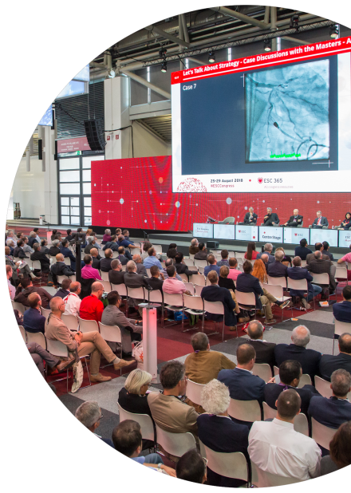
Regional rationale
ESC is a renowned and trusted learned Society in Asia
Already 30,000 members from the region
ESC flourishes from long-standing collaborative relationships in place with regional partners - APSC, AFC & ESC Affiliated Cardiac Societies
ESC is the only global society that covers the broad spectrum of cardiology through its subspecialty communities in Asia
There is a strong demand for ESC Science from the region
- ESC Congress recognised as the global cardiology event - for presenters and delegates
Japan is the #1 country for submission of abstracts to ESC Congress
Japan and China are #5 and #7 respectively, with over 2,000 attendees combined from these countries
ESC Clinical Practice Guidelines and Journals are highly valued
- Widely used reference for best practice discussions & learning
Major opportunity to deliver ESC science and best practice to large cardiology community locally

Slide 3

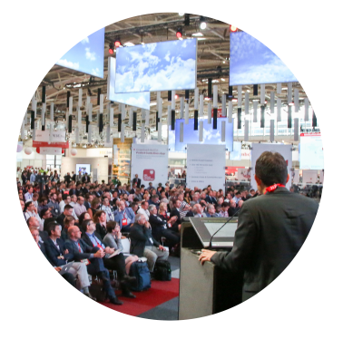
Scientific Rationale
General update and discussions on the main topics in Cardiology put in perspective for clinical practice realities in the region as well as an opportunity to discuss the impact of the largest Clinical Trials presented at ESC Congress 2019 and featured in the Highlights sessions.
Imaging
Prevention
ACS / CAD
Arrhythmias and EP
Intervention
Heart Failure
Hypertension
ESC Clinical Practice Guidelines
CVD in Diabetes
Dyslipidaemias
Myocardial Revascularization
Arterial Hypertension
Content Relevance
An opportunity for presentation of the ESC Congress Content (excellence in Science & Practical Recommendation) translated for clinical practice
in the region
Identify Best Practices and provide expert guidance on how to achieve this

Slide 4
Preliminary Congress Committee
Name | First name | Country
Achenbach | S. | Germany
Akasaka | T. | Japan
Almahmeed | W. | United Arab Emirates
Bax | J. J. | Netherlands
Casadei | B. | United Kingdom
Cowie | M. | United Kingdom
Gielen | S. | Germany
Grapsa | J. | United Kingdom
Grobbee | D.E. | Netherlands
Ibanez | B. | Spain
Johar | S. | Brunei
Kalman | J. | Australia
Komajda | M. | France
Krittayaphong | R. | Thailand
Leclerq | C. | France
Lee | A. | Hong Kong
Myeong | H | South Korea
OH | J. K. | South Korea
Pinto | F. | Portugal
Santoso | A | Malaysia
Vathesatogkit | P. | Thailand
Yasuda | S. | Japan
Zamorano | J. | Spain
Singapore Faculty
Name | First name | Country
Chi Keong | C. | Singapore
Ding | Z-P. | Singapore
Lam | C. | Singapore
Ling | L. | Singapore
Ng | R. | Singapore
Sin | KSYK. | Singapore
Tan | J. | Singapore
Yeo | K. | Singapore

Slide 5
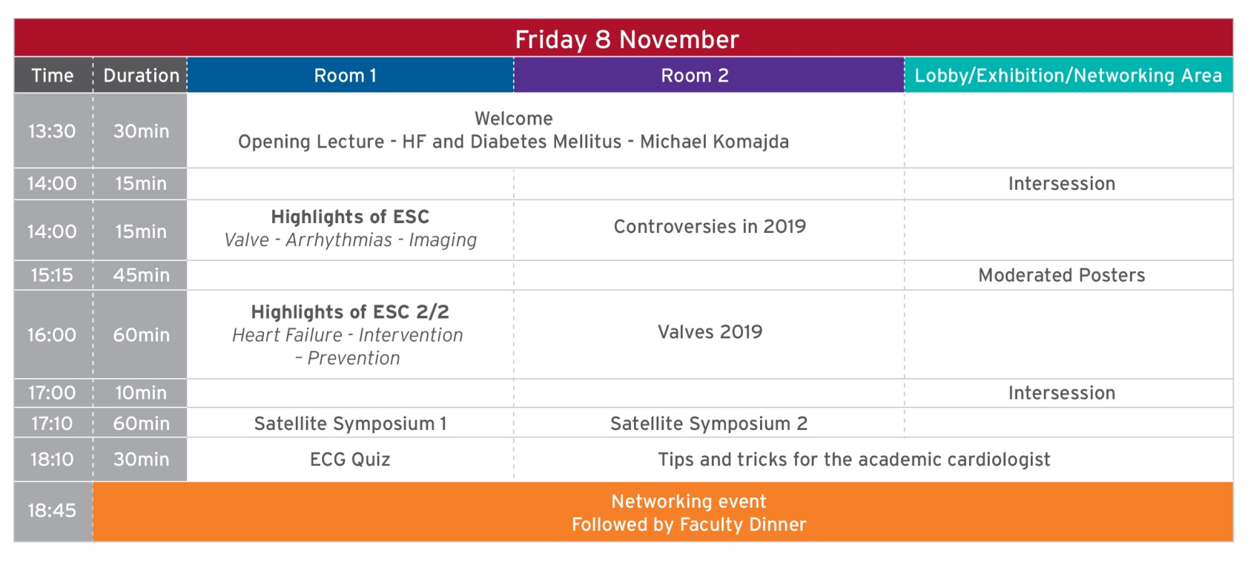
Preliminary Schedule

Slide 6
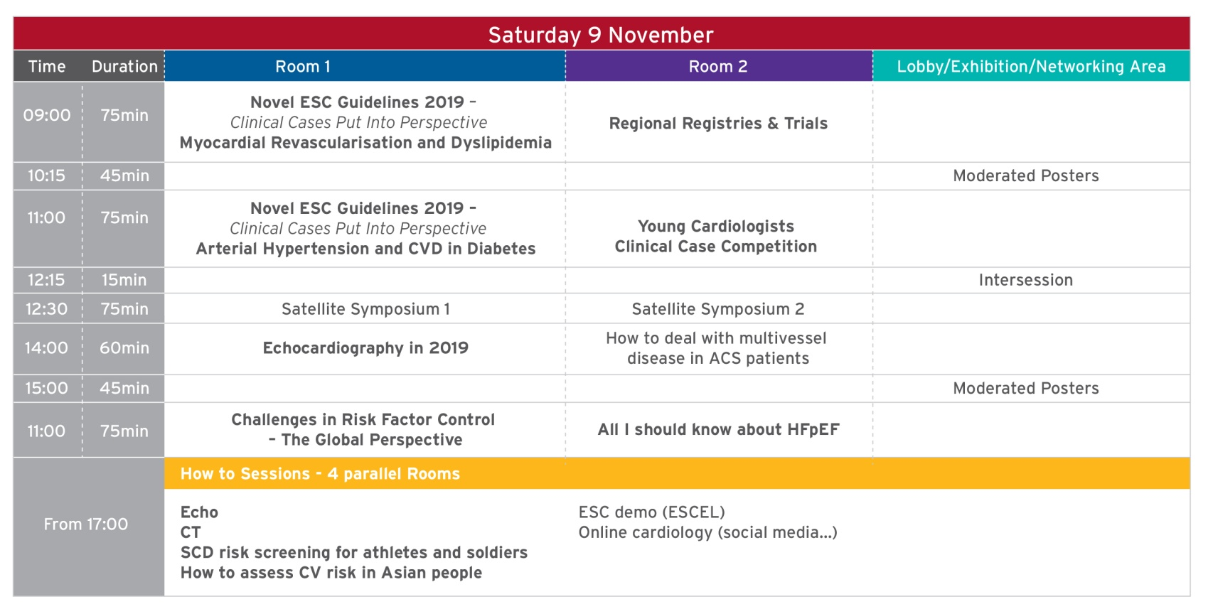
Preliminary Schedule

Slide 7
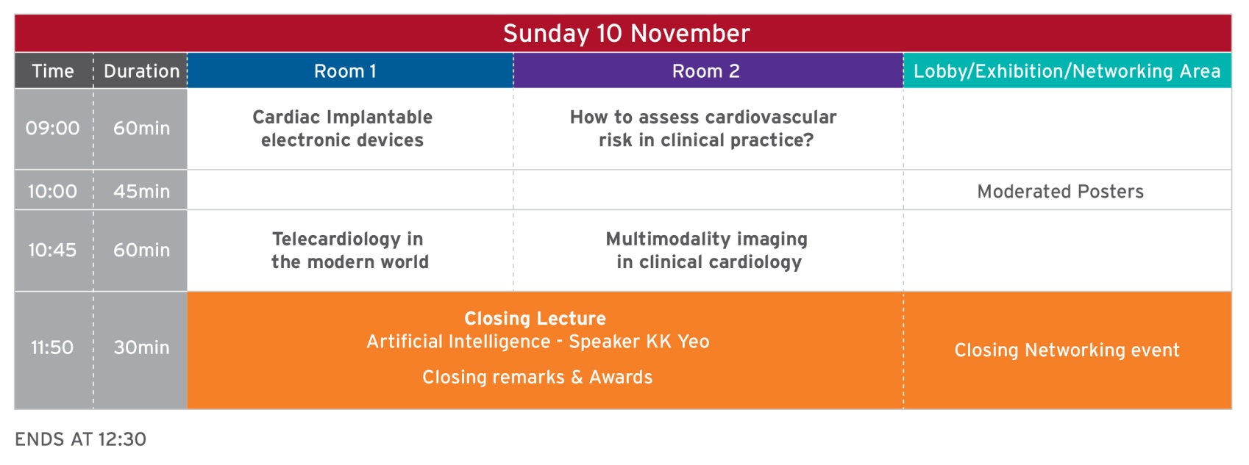
Preliminary Schedule

Slide 8

Venue
Raffles City Convention Centre in Singapore
80 Bras Basah Road
Singapore
189560
Email: conventions.singapore@fairmont.com

Slide 9

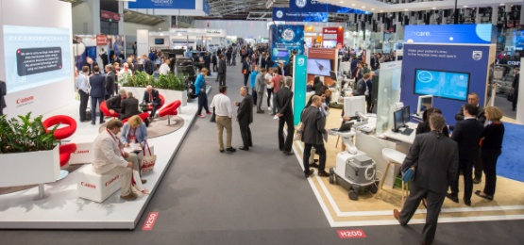
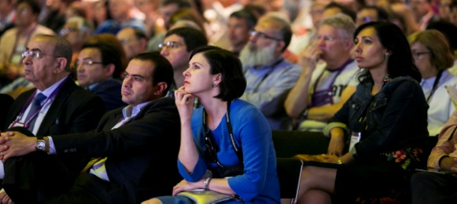
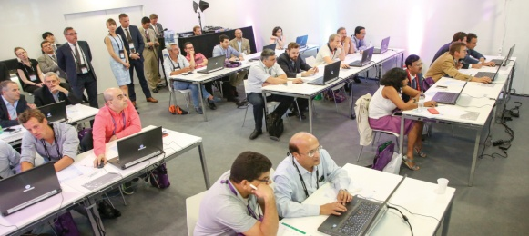
Industry Offer
Exhibition
Satellite Symposia
Practical Tutorials
The exhibition provides delegates with the opportunity to exchange with key industry experts on critical areas of development and research in cardiovascular products and therapies.
Stand Space only: per m² €400
Exhibition Package 9m²: €8,000
Companies are invited to organise Satellite Symposia that take place during the congress scientific programme.
These sessions should offer pertinent data on the latest scientific information and developments from the industry.
60 minutes €25,000
75 minutes €30,000
The following items are included in the price
of a Satellite Symposium: Room rental,
1 advert, 1 room hostess, access and use of audiovisual equipment in lecture room
Provide participants with an opportunity for hands-on and/or one-on-one learning from clinical and/or technical experts on specific areas of expertise.
One room is allocated per company for the duration of the congress.
Practical Tutorials €12,500
Price includes 1 advert
All prices are exclusive of VAT

Slide 10

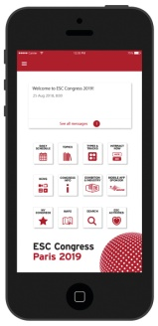
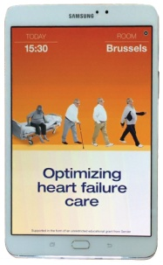

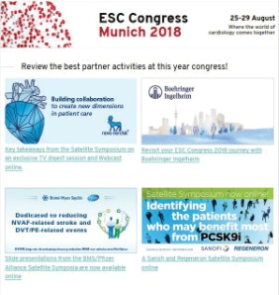
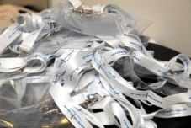
Industry Offer - Sponsorship
Webcast
€10,000
Mobile App Sponsorship
€12,500
Mobile App
Splash Adverts
€4,500
Extend the reach of your Satellite Symposium by posting the webcast of
your session on ESC 365.
Product advertising permitted in sponsor
button only
Provide delegates with this indispensable tool and showcase your company’s involvement in your dedicated sponsor section which includes:
Your advertisement in the form of sliding banners (up to 4 banners - product advertisement permitted)
Details of your sponsored sessions
Stand positioning
Your activities on site
Contact details
No product
advertising permitted
Promote your session with a 4-second teaser advertisement.
Pre-Congress eBlast €4,500
Available slots:
- Friday 8 November
- Saturday 9 November
Product advertising permitted for exhibition adverts only
Promote your exhibition space or sponsored sessions to all pre-registered delegates a few days prior
to the congress.
Delegate Badge Laces €8,000
No product advertising – exclusive sponsorship
Display your corporate name and logo on this highly visible marketing tool, which will be worn by all delegates.
A customised mailing will be sent out on 7 & 8 November in order to increase delegate awareness surrounding your activities.
All prices are exclusive of VAT

Slide 11






Packages
Essentials
Premium
Essentials
Premium
€34,000
€38,000
€39,000
€43,000
Stand Package 9m²
Satellite Symposium
Pre-Congress eBlast
Stand Package 9m²
Satellite Symposium
Pre-Congress eBlast
Webcast
Stand Package 9m²
Satellite Symposium
Pre-Congress eBlast
Stand Package 9m²
Satellite Symposium
Pre-Congress eBlast
Webcast
60
mins
75
mins
All prices are exclusive of VAT

Slide 12

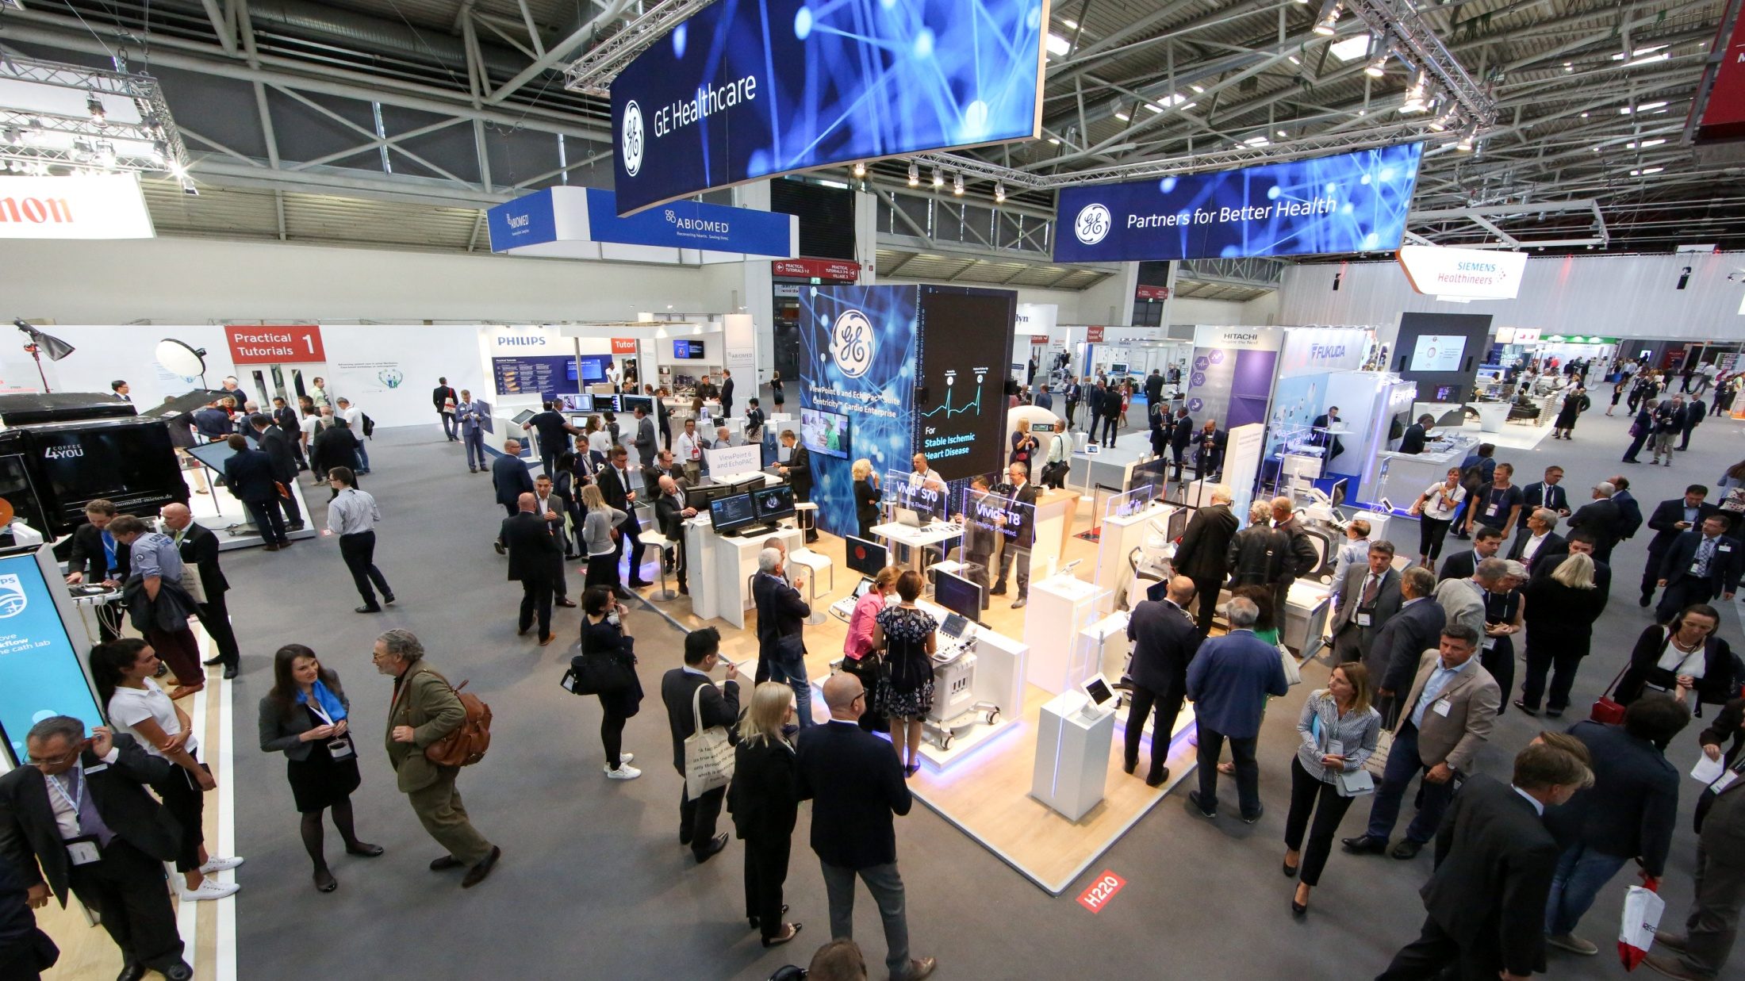

ESC Contacts
ORGANISER
European Society of Cardiology (ESC)
2035 Route des Colles, Les Templiers
CS 80179 BIOT
06903 Sophia Antipolis Cedex
France
Tel.: +33 (0)4 92 94 76 00
Fax: +33 (0)4 92 94 76 01
Email: escasia@escardio.org
Website: www.escardio.org
CONGRESS TEAM
Industry Relations
Mr. Malek Lebsir
Email: industry@escardio.org
Industry Services
Mr. Fabrice Calabrese
Email: industry_services@escardio.org
Exhibition, Industry Sponsored Sessions,
Sponsorship
Mrs. Abir Ghorab
Email: escasiaservices@escardio.org
Congress Management
Mrs. Eva Satgé
Email: escasia@escardio.org

