Slide 1



Slide 2
Table of content
General Conditions and Description
Function Spaces Location Within The Congress Centre
Function Spaces Location Within The Exhibition Area
Function Spaces Assignment: Rooms 1-12
Function Spaces Assignment: Rooms 13-18
Function Spaces Auxiliary Services Catalog
Function Spaces Internet Solutions
Function Spaces Signage/Branding
Function Spaces Catering
Function Spaces Access Schedule
Rental Of Additional Function Spaces

Slide 3
General Conditions and Description
The ESC will build standard sound-reduced rooms of 50m² within the congress centre. Each room has a surface of 6mx8.5m. (50m² internal space). These state of the art rooms are located in the exhibition halls.
PRODUCT SPECIFICATION:
  Function Spaces will include standard electricity supply (4 sockets -1 per wall- 1,5Kw each and general control box outside the back wall including 1 plug RJ45 for internet connection, and adaptation of electric system for 9,9Kw switchboard), air-conditioning (2 air conditioner 12.000 Btu separately adjustable), lighting (composed of n°12 – no dimmer – Led spotlights 18W each, 4000K neutral light and emergency light above the door) daily cleaning and double sliding doors locked with a coded key pad (codes will be provided before congress start).
  Furniture, AV and customisation need to be ordered from StudioArancio, ESC official suppliers, through their online catalog (username: ESC, password: 2017) and are billable as extras.
  External walls cannot be altered or modified without a written consent to be requested by email at congress@studioarancio.net attaching a specific request. No desk and table are allowed outside the rooms.
  Catering must be ordered from GastroFira, ESC official caterer and is billable as extras.

Slide 4
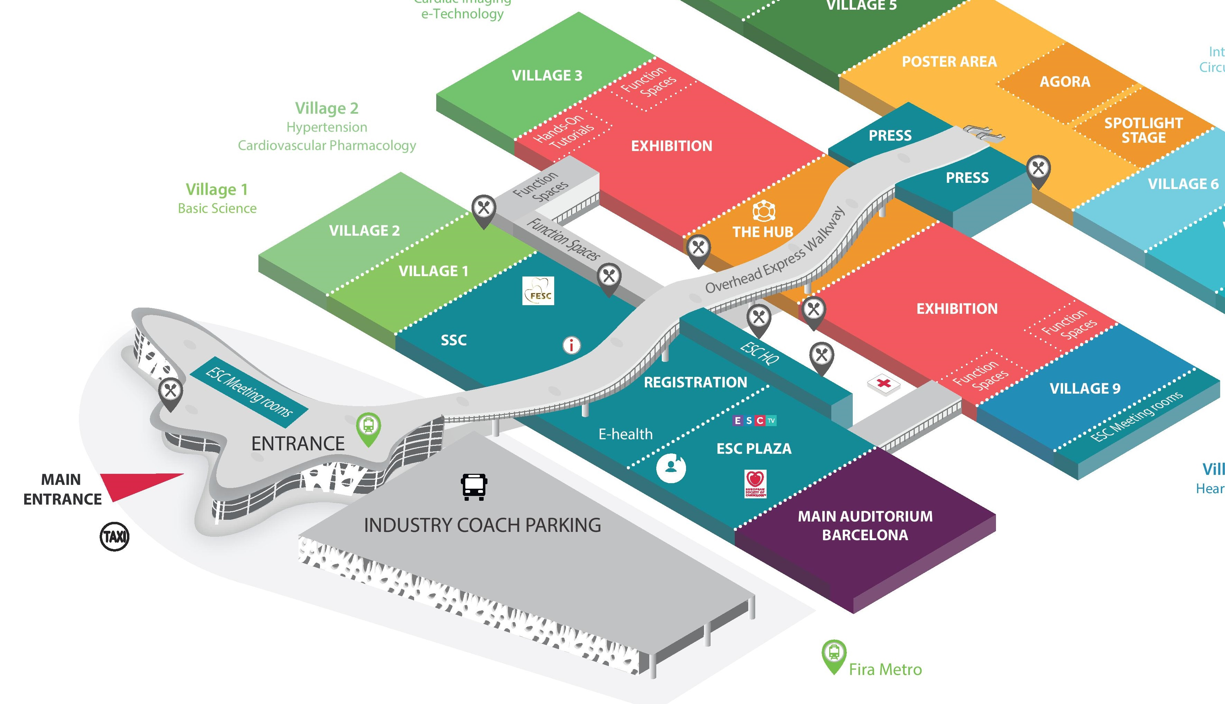
Function Spaces Location Within The Congress Centre

Slide 5
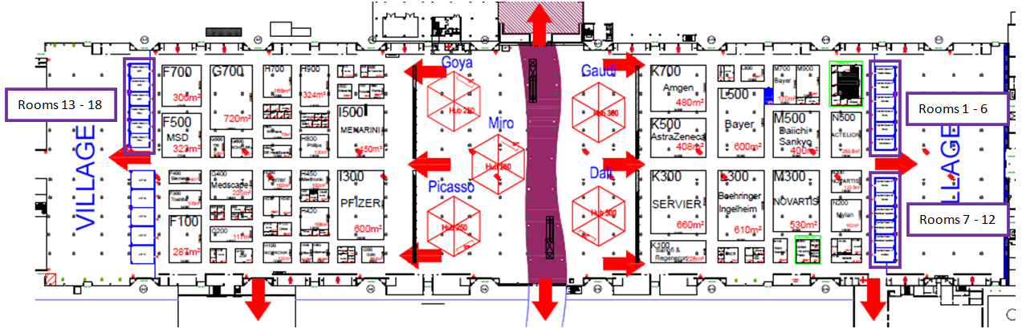
Function Spaces Location Within The Exhibition Area

Slide 6
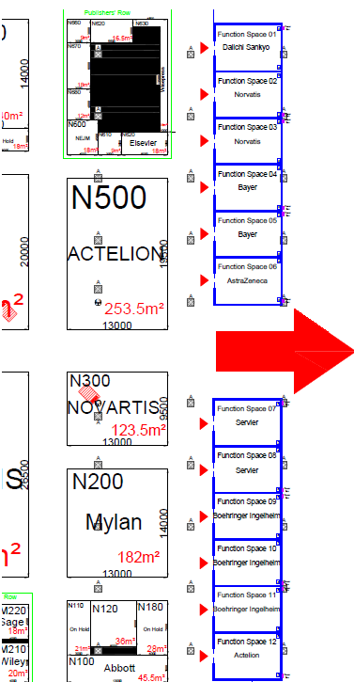
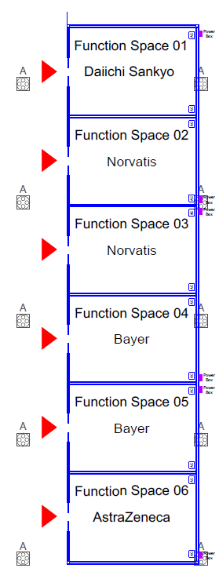
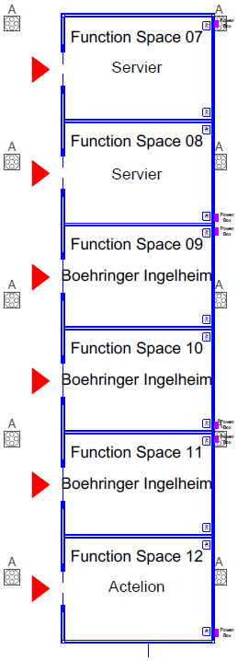
Function Spaces Assignment – Rooms 1-12
Rooms 1 - 6
Rooms 7 - 12
Rooms 1 - 6
Rooms 7 - 12

Slide 7
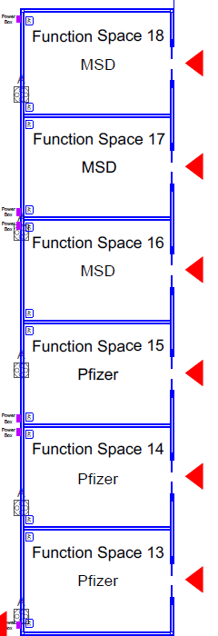
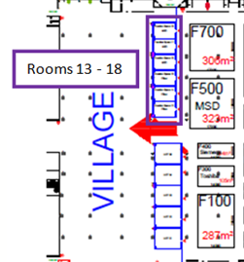
Function Spaces Assignment – Rooms 13-18

Slide 8

Function Spaces Auxiliary Services Catalog
We are pleased to present and share with you our full catalog to setting up your Function Space(s).
Transform your Function Space(s) into the main place for your Industry meetings with high quality furniture, audio video equipment and customisation items such as floors covering and many others.
Please discover the catalog and the order form on the StudioArancio website (username: ESC, password: 2017)
Note that the entire invoice amount is due by August 25, 2017. The deadline for orders is 30 June, however you may still place orders before 30 July, albeit with a 20% price increase. No order will be possible after 30 July 2017.
For any queries on these services, please contact our ESC official supplier StudioArancio at congress@studioarancio.net

Slide 9
Function Space Internet Solutions
To ensure the provision of a safe and effective Internet service for you, we have deployed in collaboration with our official supplier specific technical resources to ensure a quality service.
3 different offers can be contracted to provide your Function Space with Internet:
Each room is pre-equipped with a network cable. You just have to order your Broadband Internet to make it work!
ESC Congress general Wi-Fi is available, but you can also order your own private Wi-Fi network with a decent and guaranteed bandwidth Internet access by contacting esc.internet@firabarcelona.com.
Should you decide to deploy your own Wi-Fi service, a fixed charge per access point will be payable to our official supplier who will check the conformity of your equipment and ensure no interference with the overall Wi-Fi service at ESC Congress 2017.
Deadline to place your order: 21 August 2017
Failure to report Wi-Fi equipment could lead to an immediate requirement to suspend equipment onsite.

Slide 10
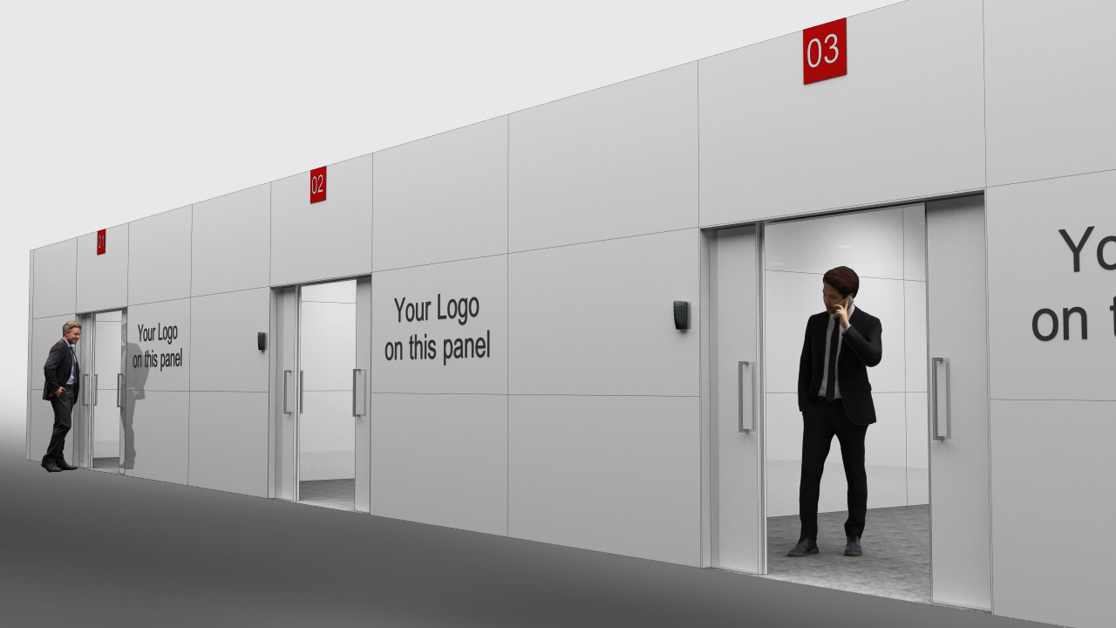
Function Spaces Signage/Branding
  The ESC will take care of the generic signage within the congress centre.
  No other signage or promotion can be made within the building.
  Additional signs, posters or roll-up placed in front of the room or anywhere else in the convention centre are not allowed and will be removed.
  1 standard room branding on the facade of the room is included in the Function Space rental:
  1 panel landscape format (200cm x 100cm)
  Room branding must receive prior approval from the ESC (company name, corporate logo & visual only). Deadline: 30 June 2017
  The room number will be indicated on the top of room entrance doors.
Specifications are as follow: FORMAT AND RESOLUTION:
RASTERIZED FILES: scale 1:1 (Final dimension) - method CYMK - final resolution at least 100dpi
alternatively file with proportional dimensions (example: dim. 100x200cm. final 100dpi, dim. 25x50cm. file at 400dpi)
CHARACTERS: Converts to paths or attach font folder
ACCEPTED FORMATS: Ai, Eps, Jpg, Tiff, Pdf, Psd
ADHESIVE LOGO: vector format
  N.B: In case of logos without shading, the logo will be stuck on the lacquered panel.

Slide 11
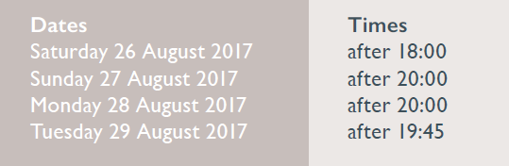
Function Space Catering
  Catering services within the Function Spaces can be organised with GastroFira, ESC’s official caterer, at the sponsor’s expense (deadline: 9 August).
  For orders and estimates please contact GastroFira:
  Maria Muñoz: mmunoz@firabarcelona.com +34 93 233 3911
  Companies will have the right to serve alcoholic beverages at the following dates and times only:

Slide 12
Function Space Access Schedule
Friday 25 August 2017
08:00-23:00 Access for exhibitors - Room set-up and decoration allowed
Access for delegates not allowed
Saturday 26 August 2017
07:00-21:00 Access for exhibitors
07:00-21:00 Access for delegates
Sunday 27 August, Monday 28 August 2017
07:00-21:00 Access for exhibitors
07:00-21:00 Access for delegates
Tuesday 29 August 2017
07:00-24:00 Access for exhibitors
07:00-18:00 Access for delegates
20:00-24:00 Removal of Function Spaces valuables
Wednesday 30 August 2017
07:00-13:00 Access for exhibitors and delegates not allowed
Function Spaces are no longer available

Slide 13
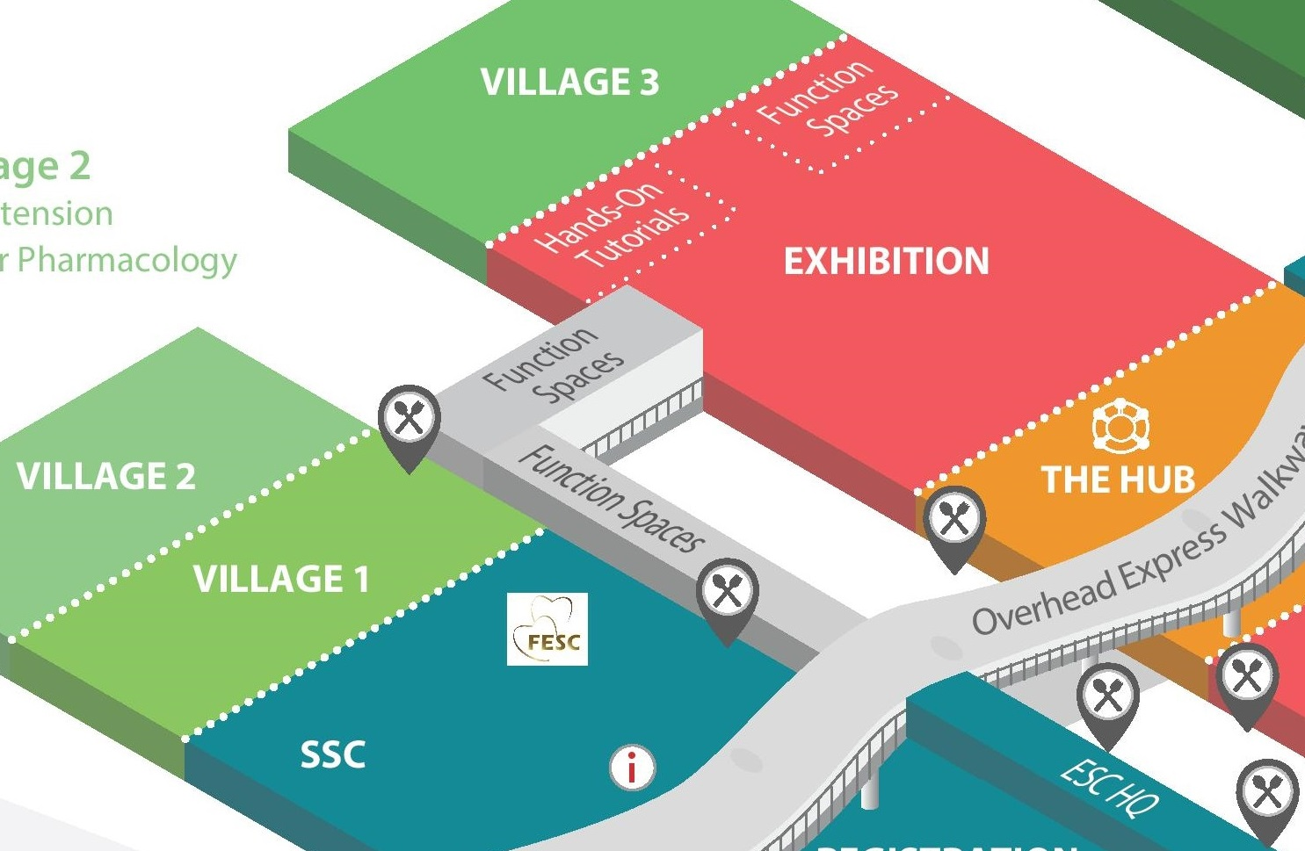
Rental Of Additional Function Spaces
If need be, a number of 16m² and 18m² Function Spaces are still available for rental in the Europa Suite area located here:
Do contact us at roomservices@escardio.org for further information.

Slide 14
Thank you!
The ESC wishes you a very successful ESC Congress 2017 in Barcelona

