Slide 1
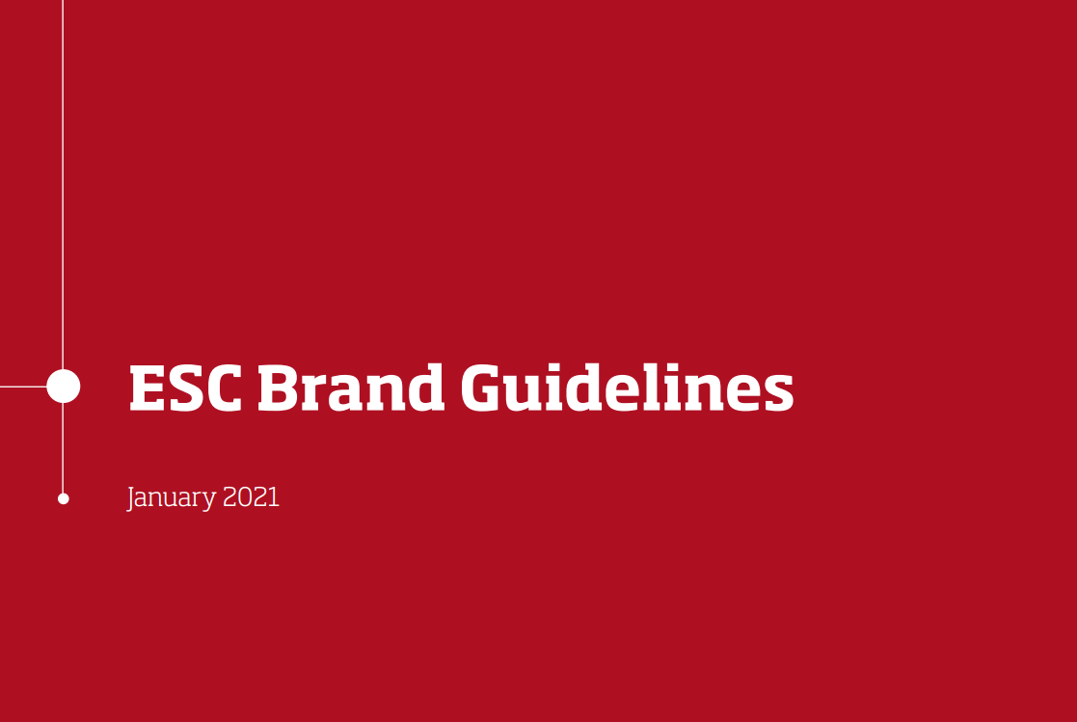
SPONSORSHIP & ADVERTISEMENT
Technical Specifications & Deadlines

Slide 2
SUMMARY
DEADLINE FOR SPONSORSHIP PRODUCTS
EBLAST
ADVERT BROADCAST
HOMEPAGE DYNAMIC BANNER
EXHIBITION DYNAMIC BANNER
SESSION PAGE STATIC BANNER
EDAILY BULLETIN BANNER
ONLINE PROGRAMME DYNAMIC BANNER
BADGE LEAD MANAGEMENT SYSTEM
COLLECTION OF AUDIENCE LEADS AND ANALYTICS

Slide 3
MENU
DEADLINE TO SEND FINAL FILES FOR SPONSORSHIP PRODUCTS TO ehra-congressservices@escardio.org
ORDERED PRODUCT
DEADLINE TO SENT THE ARTWORK
Application deadline with priority status
30 October 2022
Onsite Advertising
3 March 2023
Pre-Event Eblast 28 March
3 March 2023
Pre-Event Eblast 4 April
10 March 2023
Advert Broadcast
Event Eblast (16-17-18 April)
Homepage Dynamic Banner
Exhibition Section Dynamic Banner
Session Video Page Static Banner
Online Programme Dynamic Banner
eDaily Bulletin Banner
24 March 2023
Post-Event Eblast 3 and 10 May
19 April 2023

Slide 4
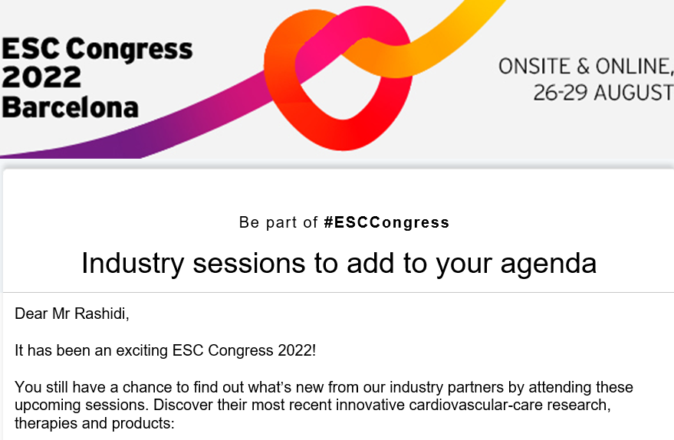
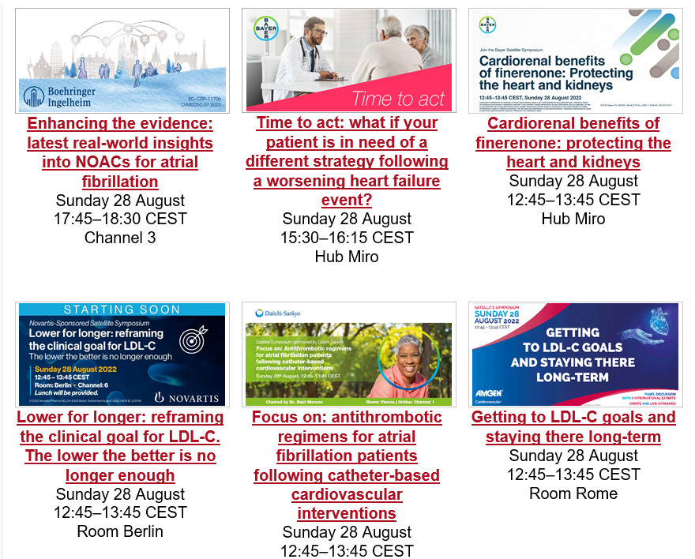

MENU
PRE-EVENT EBLAST, EVENT EBLAST & POST-EVENT EBLAST
No product advertising permitted
Take the opportunity to reach out to the audience before, during and after the event via an electronic invitation. The eBlast is the ideal way to drive our Cardiology Community to your activities and resources, including sessions.
Display order will be assigned in line with the accrued point ranking
No product advertising permitted
Elements to be provided:
1 advert image - Exact size: 600px x 300px – Maximum weight: 50 ko
1 PDF format advert (Maximum weight 1MB) or other below mentioned alternative option
Mandatory rules to follow:
Hyperlinks to an external website or virtual booth are not permitted
If you do not wish to link the advert to a PDF, please inform us about the below alternative option chosen:
-> Dedicated Exhibitor Page (available for Event eBlast)
-> Satellite Symposium online page (available for Event and Post Event eBlast)
-> Satellite Symposium’s Recorded video (Post event eBlast only)
If a Satellite Symposium is promoted, use the exact wording “Satellite Symposium” with both “S” in capital letters. All other wording will not be validated by ESC.
To mention the Congress, please use the Official pictogram of the Congress available on the ESC Industry Portal or use the exact wording “EHRA 2023”
Should those rules are not strictly followed, elements will not be validated.

Slide 5
MENU
PRE-EVENT EBLAST, EVENT EBLAST & POST-EVENT EBLAST
No product advertising permitted
Event visual and eBlast title
integrated by ESC supplier
Text edit by ESC
Advert image - the advert link will lead to a larger PDF advert – or other alternative option chosen
Session title edited and integrated by ESC supplier. Clickable link that will lead to the PDF advert or other alternative option chosen.
If Satellite Symposium promoted, information edited and integrated by ESC supplier

Slide 6
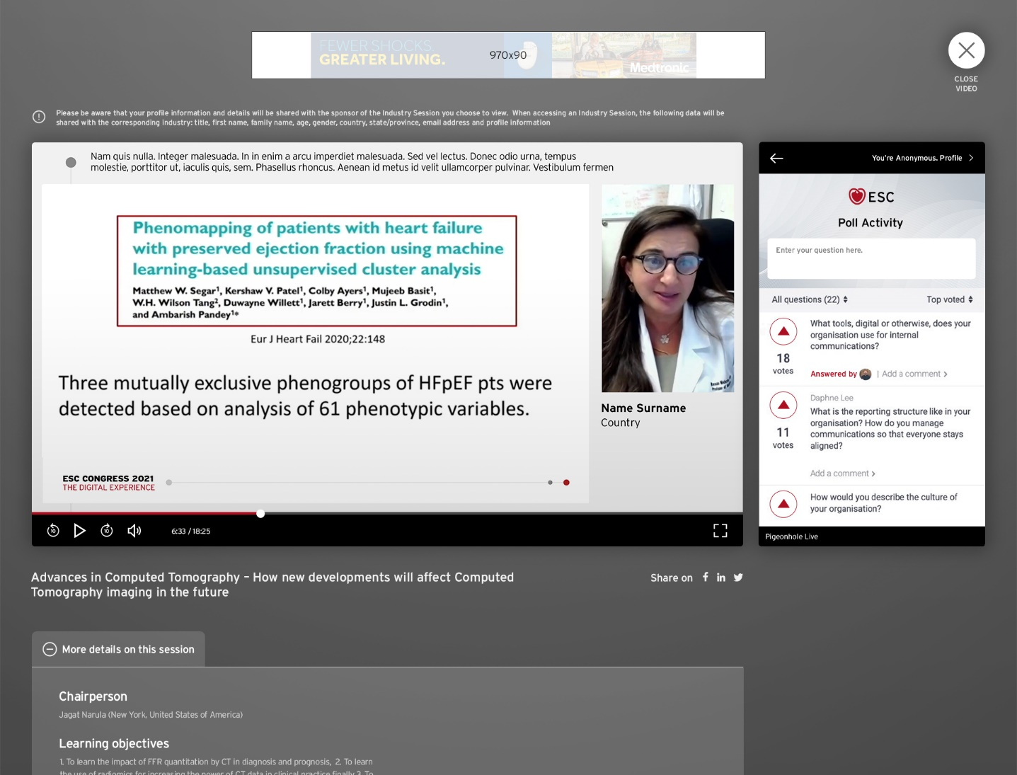


MENU
ADVERT BROADCAST
Product advertising permitted
Promote your latest innovations and activities with four 30-seconds video spots per day during our intersession slots.
Elements to be provided by the Sponsor:
High definition MP4 format video(s) of 30 seconds each with the channel's choices in :
Format: MP4
Resolution: Full HD (1920 x 1080 pixels, format 16/9)
Codec: H264
Frame Rate: 25P
Mandatory rules to follow:
Orders are limited to 2 packages per sponsor and per day
Product advertising permitted
Maximum 2 industry adverts broadcasts per intersession
All 4 videos included in the package must be broadcasted on the same chosen day with 2 in the Channel 1 Programme and 2 in the Channel Programme of your choice (same channel) – please inform us about the chosen Channel
No mono-sponsorship with same sponsor in the same intersession
Possibility to provide different video spots in each package
The key message of your video should be simple and easy to remember
Note: The ESC will be managing the distribution and programming of each Advert Broadcast at specific times in both the Channels and the Live Programmes. There will be no test version available and the exact schedule will not be known in advance, therefore the unveiling of your advert will be made at the launch of the Congress. You can trust the ESC will do its utmost to ensure your adverts are broadcast at the best possible times and are efficiently delivered throughout the day.
Should those rules are not strictly followed, elements will not be validated.

Slide 7
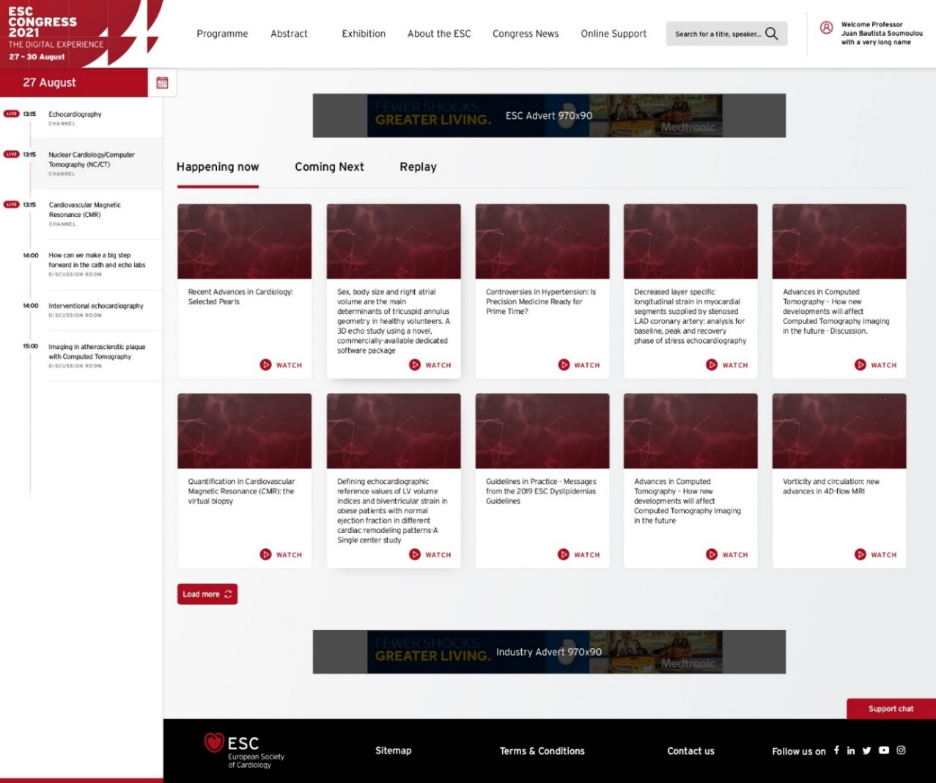
MENU
HOMEPAGE DYNAMIC BANNER
No product advertising permitted
Banner reserved for
ESC Communication
Promote your Satellite Symposium or Dedicated Exhibitor Page on the EHRA 2023 Homepage Dynamic Banners. This sliding banner will rotate every 7 seconds in a pre-determined order and will include 4 sponsors. Price is valid for 3 days and sponsors can use a different banner for each day. This item is limited to 2 banners per sponsor.
Elements to be provided by the Sponsor:
1 banner visual for desktop:
Format: JPG / PNG / GIF
Maximum size: 970px * 90px, 72 dpi
Hyperlink chosen : Dedicated Exhibitor Page or Satellite Symposium Online Page only
Mandatory rules to follow:
Hyperlinks to an external website or virtual booth are not permitted, however a hyperlink to your Dedicated Exhibitor Page or the Satellite Symposium Online page is permitted.
No product advertising is permitted
If a Satellite Symposium is promoted, use the exact wording “Satellite Symposium” with both “S” in capital letters. All other wording will not be validated by ESC.
To mention the Congress, Sponsor can use the Official pictogram of the Congress available on the ESC Industry Portal or use the exact wording “EHRA 2023”
Note: The carousel does not start on a random banner but rather is dependent on the position that was chosen by the sponsor, meaning that “Position 1” will always be shown during the first 7 seconds of the 28 seconds carousel, while “Position 4” will always appear during the last 7 seconds.
Location of the Homepage Banner for Industries
Should those rules are not strictly followed, elements will not be validated.

Slide 8
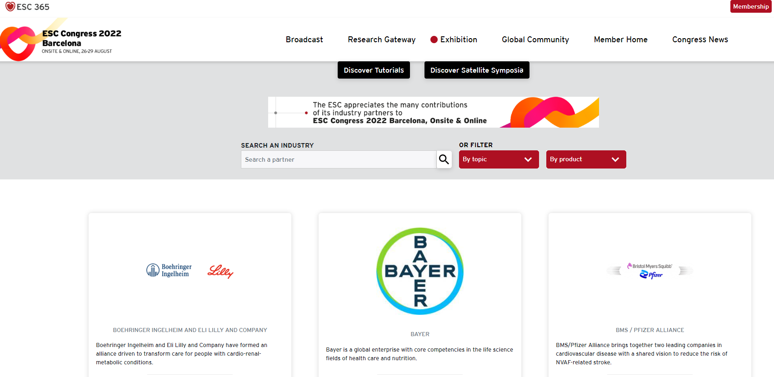
MENU
EXHIBITION SECTION DYNAMIC BANNER
Product advertising permitted
Promote your message, Satellite Symposium or Dedicated Exhibitor Page on the EHRA 2023 Exhibition Section Dynamic Banner. This sliding banner will rotate every 7 seconds in a pre-determined order and will include 4 sponsors. Price is valid for 3 days and sponsors can use a different banner for each day. This item is limited to 2 banners per sponsor.
Elements to be provided by the Sponsor:
1 banner visual for desktop:
Format: JPG / PNG / GIF - Maximum size: 970px * 90px, 72 dpi
Hyperlink chosen – Dedicated Exhibitor Page or the Satellite Symposium Online Page only
Mandatory rules to follow:
Hyperlinks to an external website or virtual booth are not permitted, however a hyperlink to your Dedicated Exhibitor Page or the Satellite Symposium Online Page is permitted.
Product advertising permitted
If a Satellite Symposium is promoted, use the exact wording “Satellite Symposium” with both “S” in capital letters. All other wording will not be validated by ESC.
To mention the Congress, Sponsor can use the Official pictogram of the Congress available on the ESC Industry Portal or use the exact wording “EHRA 2023”
Note: The carousel does not start on a random banner but rather is dependent on the position that was chosen by the Sponsor, meaning that “Position 1” will always be shown during the first 7 seconds of the 28 seconds carousel, while “Position 4” will always appear during the last 7 seconds.
Location of the Exhibition Section Dynamic Banner
Should those rules are not strictly followed, elements will not be validated.

Slide 9
MENU
SESSION VIDEO PAGE STATIC BANNER
No product advertising permitted
Location of the Session Video Page Static Banner
Promote one of your Satellite Symposium or your Dedicated Exhibitor Page during your Satellite Symposium. Price is valid for 1 session.
This banner will be visible during the Satellite Symposium of your choice and can be linked to the Dedicated Exhibitor Page or to the promoted Satellite Symposium online page.
Elements to be provided by the Sponsor:
1 banner visual for desktop:
Format: JPG / PNG / GIF - Maximum size: 970px * 90px, 72 dpi
Hyperlink chosen :Dedicated Exhibitor Page or the Satellite Symposium Online Page only
Mandatory rules to follow:
Hyperlinks to an external website or virtual booth are not permitted, however a hyperlink to your Dedicated Exhibitor Page or the Satellite Symposium online page is permitted.
If a Satellite Symposium is promoted, use the exact wording “Satellite Symposium” with both “S” in capital letters. All other wording will not be validated by ESC.
To mention the Congress, Sponsor can use the Official pictogram of the Congress available on the ESC Industry Portal or use the exact wording “EHRA 2023”
Should those rules are not strictly followed, elements will not be validated.

Slide 10
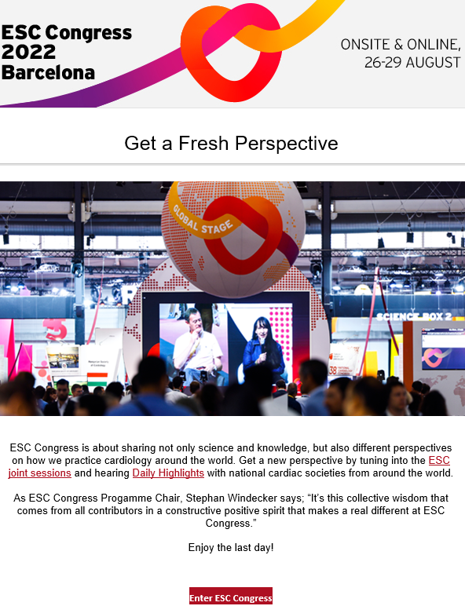

MENU
eDAILY BULLETIN BANNER
No product advertising permitted
Extend your visibility and promote your Satellite Symposium or exhibition activities via our dedicated congress bulletin highlighting the most up-to-date scientific information from EHRA 2023. It will be emailed to our database of healthcare professionals with a My ESC account. Price is valid for 1 day.
Elements to be provided:
1 banner visual:
Format: JPG / PNG - Maximum size: 600px * 150px, 72 dpi
Hyperlink chosen - Dedicated Exhibitor Page or the Satellite Symposium Online Page only
Mandatory rules to follow:
Hyperlinks to an external website or virtual booth are not permitted, however a hyperlink to your Dedicated Exhibitor Page or the Satellite Symposium online page is permitted.
If a Satellite Symposium is promoted, use the exact wording “Satellite Symposium” with both “S” in capital letters. All other wording will not be validated by ESC.
To mention the Congress, Sponsor can use the Official pictogram of the Congress available on the ESC Industry Portal or use the exact wording “EHRA 2023”
Location of the
eDaily Bulletin Banner
Should those rules are not strictly followed, elements will not be validated.

Slide 11
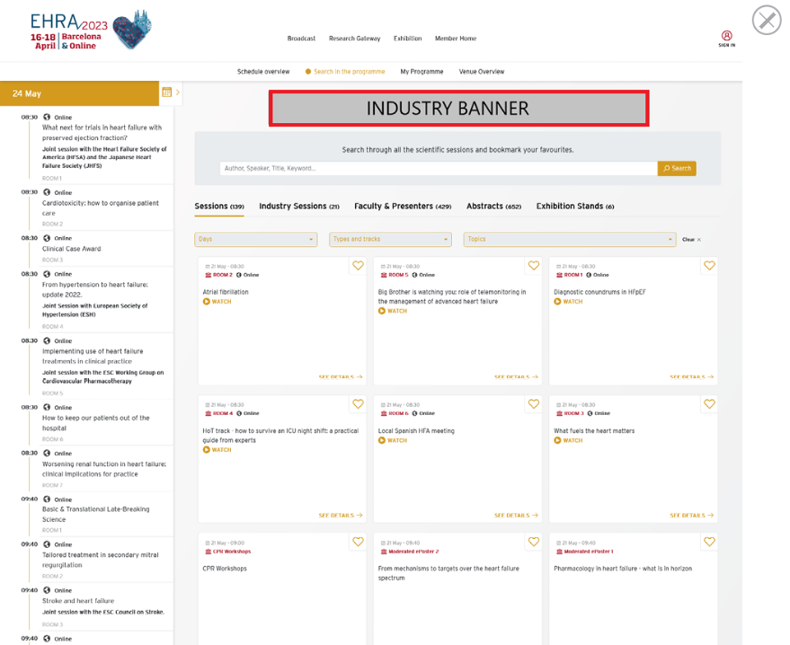
MENU
ONLINE PROGRAMME DYNAMIC BANNER
No product advertising permitted
Extend your visibility and promote your Satellite Symposium or exhibition activities via our dedicated congress bulletin highlighting the most up-to-date scientific information from EHRA 2023. It will be emailed to our database of healthcare professionals with a My ESC account. Price is valid for 1 day.
Elements to be provided:
1 banner visual:
Format: JPG / PNG - Maximum size: 600px * 150px, 72 dpi
Hyperlink chosen Dedicated Exhibitor Page or the Satellite Symposium Online Page only
Mandatory rules to follow:
Hyperlinks to an external website or virtual booth are not permitted, however a hyperlink to your Dedicated Exhibitor Page or the Satellite Symposium online page is permitted.
If a Satellite Symposium is promoted, use the exact wording “Satellite Symposium” with both “S” in capital letters. All other wording will not be validated by ESC.
To mention the Congress, Sponsor can use the Official pictogram of the Congress available on the ESC Industry Portal or use the exact wording “EHRA 2023”
Should those rules are not strictly followed, elements will not be validated.

Slide 12
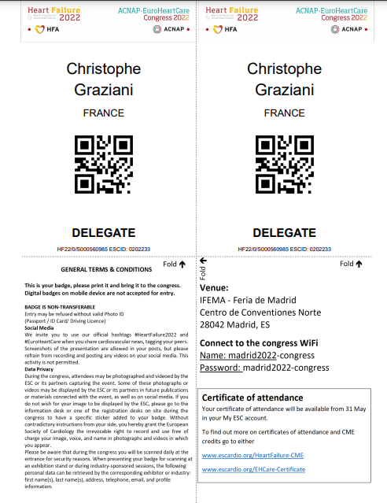
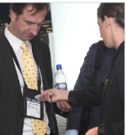
MENU
BADGE LEAD MANAGEMENT SYSTEM
Access information from EHRA 2023 delegate badges in real time, enabling your exhibit or symposium staff to store, edit and amend delegate data using your own hardware and software by scanning this information from the delegate badges to your database.
The sponsor will implement a programme to use this interface in order to retrieve the delegate information during the congress period. The industry partner must conform to the technical details that will be provided by the ESC.
When you order a Badge Lead Management System, it orders the System only, the badge readers are not included. Please find the user guide here.
Should you need help with the lead retrieval, you have to contact the official supplier directly.

Slide 13


MENU
COLLECTION OF AUDIENCE LEADS AND ANALYTICS
All registered profile information and details will be shared with Sponsorship and Advertisement items’ sponsors.
We will provide you with the following data for all individuals who consult these items: title, first name, family name, age, gender, country, state/province, email address, and profile information.
Those datas will be uploaded in a Shared Folder via within 15 days after the end of the Congress.

Slide 14
MENU
INDUSTRY SPONSORED SESSION DISPLAY SCREEN
No trademarks, no product name or product logo will be allowed
Elements to be provided by the Sponsor:
1 visual:
Format: JPG / Powerpoint
Exact resolution: 1366 x 768
Format: 16:0
Duration: 30” Presentations will run until the session has taken place during the congress
Mandatory rules to follow:
1 advert can promote only 1 event (Satellite Symposium or Booth activity)
1 advert promoting 1 Satellite Symposium with reference to a booth will be considered as 1 advert.
If a Satellite Symposium is promoted, use the exact wording “Satellite Symposium” with both “S” in capital letters. All other wording will not be validated by ESC.
To mention the Congress, Sponsor can use the Official pictogram of the Congress available on the ESC Industry Portal or use the exact wording “EHRA 2023”
Note: Distinguish your Sponsored Sessions from the rest by broadcasting an advertisement on the large information screen located in a prime location. Include your Industry Sponsored Sessions advertisement on this large info screen to attract immediate delegate attention and ensure additional visibility for your sessions. This screen will be located on the ground floor between hall 3 and hall 3.
Pas pour EHRA
Should those rules are not strictly followed, elements will not be validated.

Slide 15
MENU
ECONGRESS NEWS DYNAMIC BANNER ????
No product advertising permitted
Pas pour EHRA

