Slide 1

EHRA 2022
Sunday 3 (AM) - Tuesday 5 April (PM) 2022
Copenhagen, Denmark
Virtual Industry Site Visit
Friday 24 September 2021

Slide 2

Agenda
1. Introduction & welcome – I. Dor
2. 2021 Key figures & 2022 Congress survey results – A. Leuba
3. Presentation of the 2022 congress format - C. Leclercq
4. Venue Presentation – A. Leuba
5. Industry opportunities – I. Dor
6. Questions & Answers - ALL

Slide 3

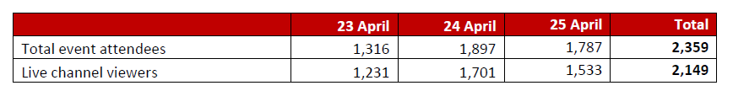
EHRA 2021 Online- Statistics
Total Registrations 3,436
Total event attendees: 2,359

Slide 4
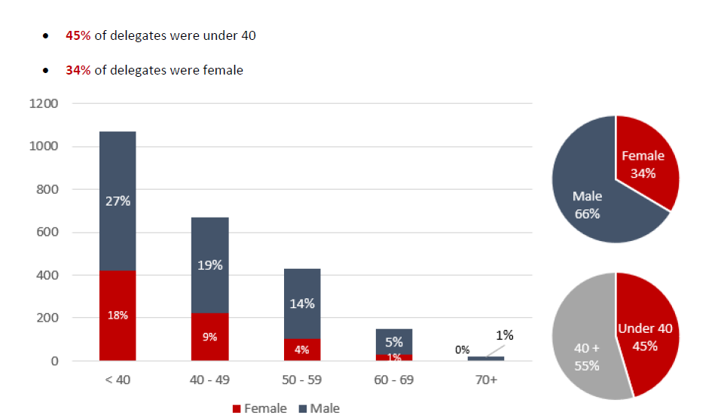
EHRA 2021 Online- Statistics

Slide 5

EHRA 2022- Survey results (sent in Sept. 2021)
Objectives
2022 Congress awareness on format, abstract presenters’ & delegates’ opportunities
Onsite/Online participation & expectations in terms of scientific content
This survey was sent to:
1. All EHRA Members, past EHRA Congress delegates (last 3 editions)
2. Abstract presenters (last 3 editions)

Slide 6
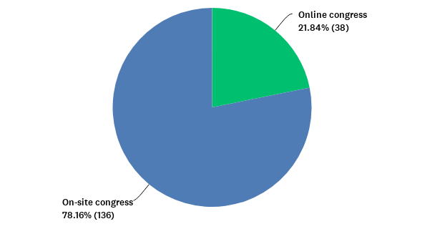
Vast majority (78%) will now choose on-site attendance
In 2022, which format of the congress are you more likely to choose?
Notes:
This result is the highest of all specialty congresses (Preventive : 58% on-site, ACVC : 48%).

Slide 7
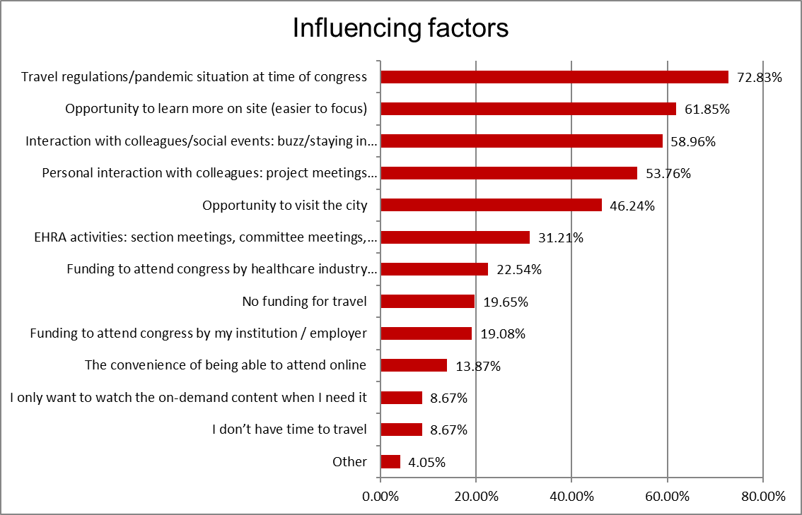
Which factors will influence the format of the congress you choose?
Travel regulations and pandemic situation will be the #1 factor

Slide 8
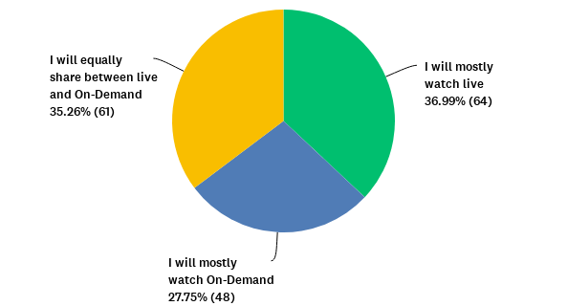
Online attendance: Will you preferably watch the sessions live or On-Demand?
Watching live is preferred and combining with on-demand is often favoured

Slide 9
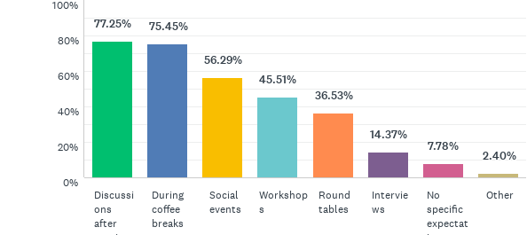
If you plan to attend on-site in Copenhagen, Denmark, where do you expect to interact with your colleagues and key opinion leaders?
Most delegates expect to interact ‘after sessions’ or ‘during coffee breaks’

Slide 10










EHRA 2022 Format
Sunday 3 April (AM) to Tuesday 5 April (PM)
Streamed live from Copenhagen
ONSITE
ONLINE
Bella Center, Copenhagen
Online audience (Objective: 1 500pax)
Onsite participation (Objective: 2 500 pax)
Live access to 40% scientific via the congress event platform
= 2 channels over 3 days
5 Lecture rooms running in parallel
Sponsored sessions, exhibition and networking opportunities
Abstract and clinical case presentations will be digital but also onsite
Rapid fire sessions
Delegate coffee breaks and networking events
Daily interactions
Notes:
Bernard to present

Slide 11

EHRA 2022: Audiences
Target audience
ONSITE | ONLINE
Faculty/ Key Opinion Leaders Health Care Professionals most likely to attend and willing to network & meet again with peers Delegates from EU & neighboring countries | Worldwide audience who could not afford or could not come physically in Copenhagen due to COVID restrictions Under 40 National Cardiac Societies countries
Notes:
Alessia to present

Slide 12
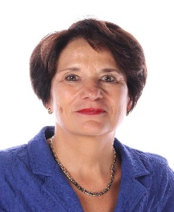
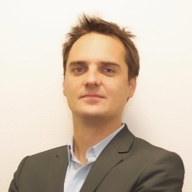
Congress Scientific Programme committee members
Prof. Isabelle Van Gelder
EHRA Scientific Programme Chair 2021-2022
Dr. Tom De Potter
EHRA Scientific Programme
Co-Chairperson 2021-2022
AF ablation | Dipen Shah
 | Luigi di Biase
 | Micaela Ebert
Live case AF ablation | Lluis Mont
VT ablation | Josef Kautzner
 | Frederic Sacher
 | Thomas Deneke
Live cases VT ablation | Christian De Chillou
SVT | Demosthenes Katritsis
Pediatrics/GUCH | Joris Ector
PM, ICD | Mauro Biffi
 | Jonathan Behar
 | Francesco Zanon
 | Frieder Braunschweig
CRT & lead extraction | Kevin Vernooy
 | Archana Rao
 | Rasmus Borgquist
 | Mario Martins Oliveira
ECG, Rhythm diagnostics & syncope | Angel Moya I Mitjans
 | Pascal Defaye
 | Nicholas Gall
 | Kristine Jubele
Imaging techniques | Mark O'Neill
SCD | Xavier Jouven
 | Nikolaos Dagres
Clinical AF, Stroke&anticoagulation | Michiel Rienstra
 | Jan Steffel
 | Przemyslaw Piotr Mitkowski
Inherited cardiopathies (ECGEN rep) | Jacob Tfelt-Hansen
Digital | Emma Svennberg
 | Mintu Turakhia
WGCCE rep | Ana Gomez
Abstract chair | Stylianos Tzeis
Patients representative | Inga Drossart

Slide 13
EHRA 2022: Scientific programme
Main theme: BACK TO THE RHYTHM
ONSITE
A large scientific offer: 80 scientific sessions, excl. abstract-based sessions
Exclusive access to experts: maximise onsite attendance of the Faculty
Favor interaction: scientific session formats of 40 minutes with 20 minutes of discussions
Networking opportunities: larger morning and afternoon coffee breaks, networking opportunities
ONLINE
Maximise exposure: abstracts & clinical cases will be digital - except the top-rated abstracts who will be featured in pre-arranged sessions
Favor interaction: Online delegates will be able to ask questions and chat with the audience live
Notes:
Denisa to present

Slide 14
Congress Timeline
October – Scientific programme finalisation & Faculty invitations
6 October - 5 January - Call for abstracts
6 October - 7 January - Call for clinical cases
25 October – 12 January - Call for technology
6 December – 25 January - Call for Late-Breaking Science
Early February - Abstract results announcement
Early Registration Deadline – 3 Feb
Late registration Deadline - 5 April
Call for science
Registration

Slide 15
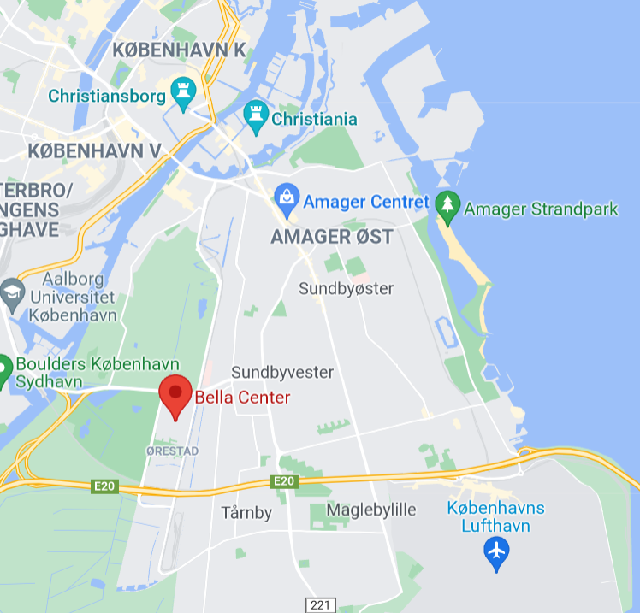
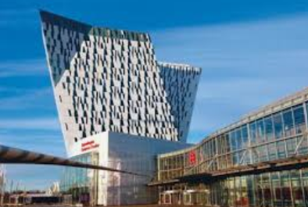
Venue: Bella Centre Copenhagen
Central location with unique infrastructure
Bella Center Copenhagen features a central location in the heart of Ørestad with its own Metro station (M1).
Bella Center Copenhagen is just:
6 kilometers away from Copenhagen Airport (10mn drive)
8 kilometers away from Copenhagen city centre
Notes:
A taxi from Bella Center to the city centre costs about DKK 200.
A taxi from Bella Center Copenhagen to Copenhagen Airport costs about DKK 150-200.

Slide 16
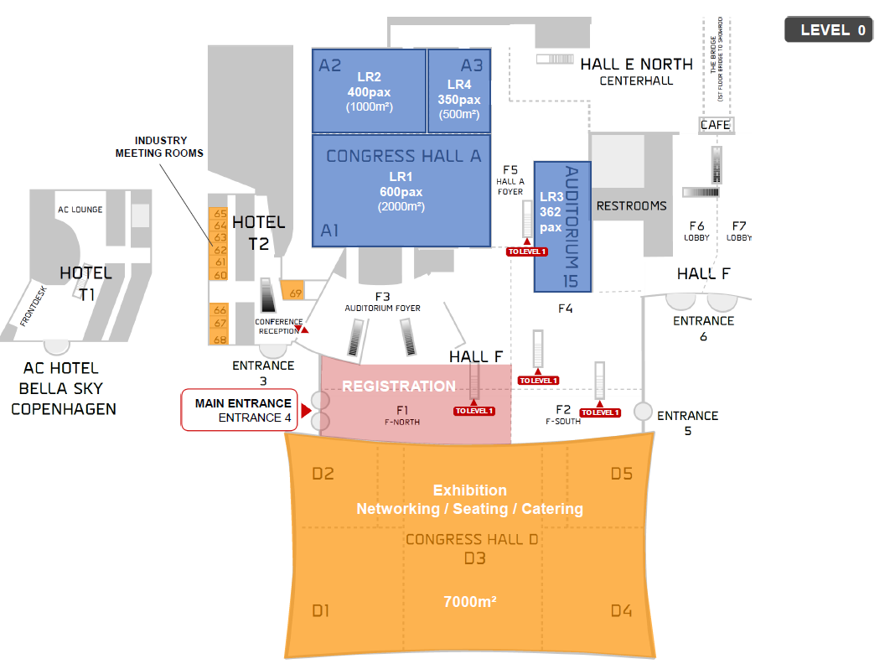
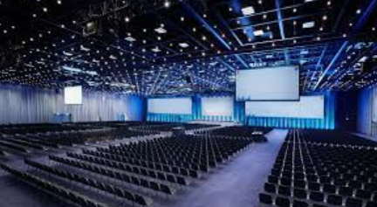
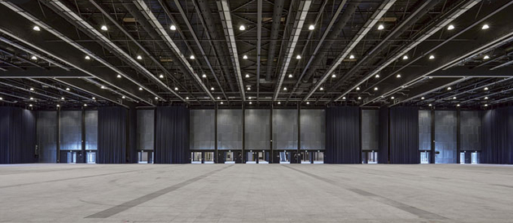
Preliminary Floorplan
Registration area
Exhibition area
Catering & seating area
Lecture rooms
Industry meeting rooms
Live reports
(interviews for online audience)

Slide 17
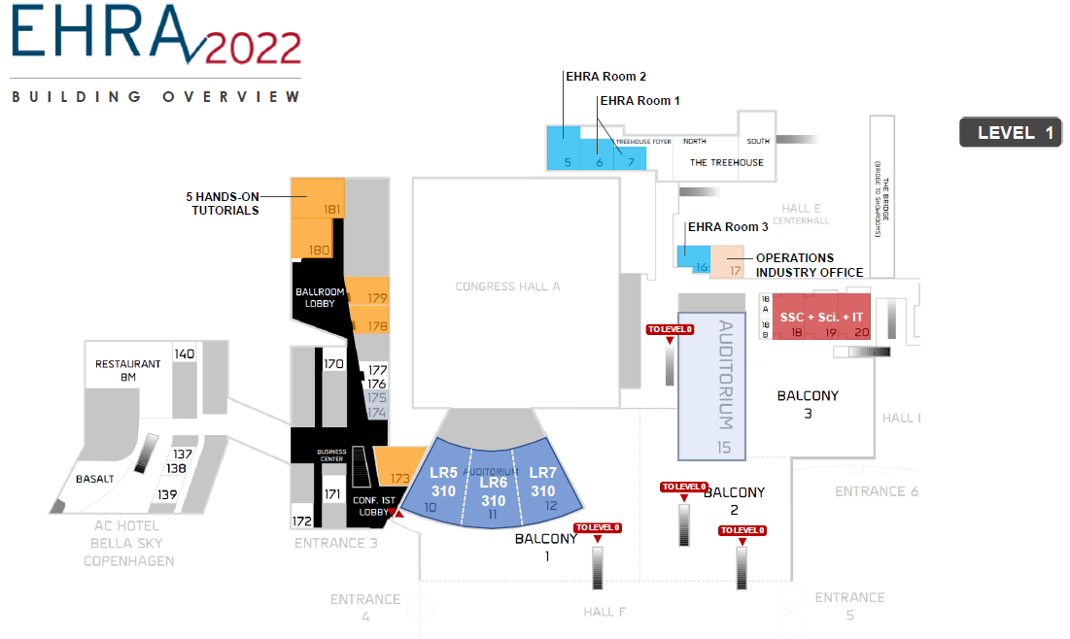
Lecture rooms
Speaker Service Centre
Hands on tutorials (TBC)
EHRA Meeting rooms

Slide 18

Hotel, social events & hostesses
MCI Copenhagen has been selected as the local partner and will be able to assist the EHRA industry partners with:
Group bookings of hotel rooms
Corporate hospitality, Dinners & transfers
Local hostesses
Contact: copenhagen@mci-group.com
Phone: +45 70222230
Contact person: Per Ankaer

Slide 19
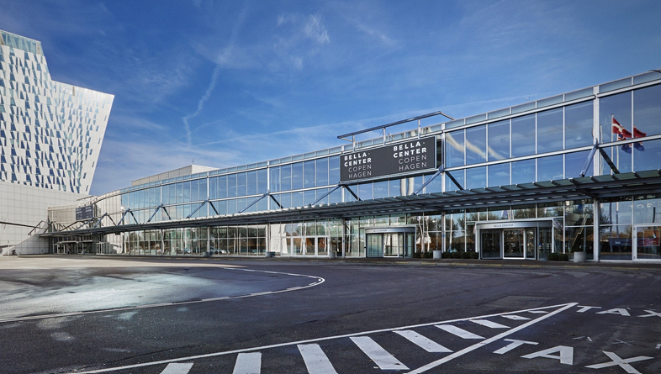
BACK TO THE RHYTHM
Exhibition Area
Satellite Symposia
Tutorials
Meeting Rooms
Poster Area
Networking
On line Channels
Live report (wrap ups)

Slide 20
3 Days
25 slots
Format
Type
Dynamic programme of 80 sessions, 5 lecture rooms, networking breaks each day. channels online with a selection of scientific programme streamed live, and 2 summary report per day for the online community
9 slots available on day 1 9 slots available on day 2 7 slots available on day 3
Choice of exclusive , limited to 1 per Industry Choice of non-exclusive slots, limited to 2 slots running in parallel Choice of either 45mn & 30mn slots
Several possibilities to disseminate your latest sciences and innovations

Slide 21
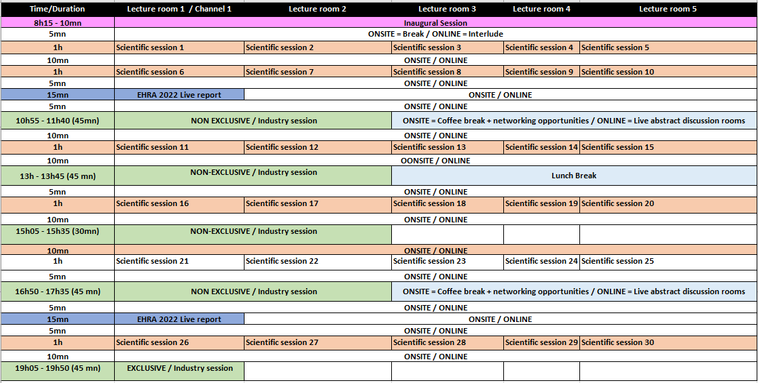
TIME SCHEDULE
DAY 1
Notes:
Low competition

Slide 22
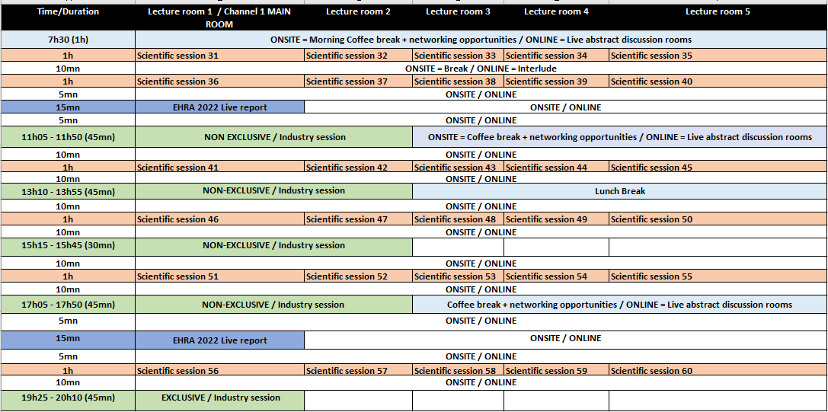
TIME SCHEDULE
DAY 2

Slide 23
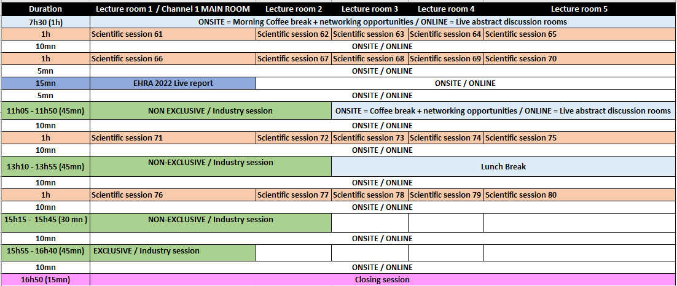
TIME SCHEDULE
DAY 3

Slide 24
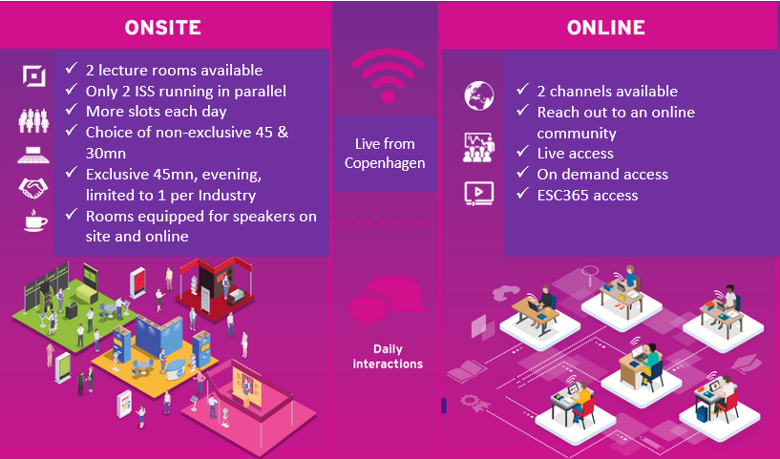
Industry Sponsored Session
The Best of both worlds

Slide 25
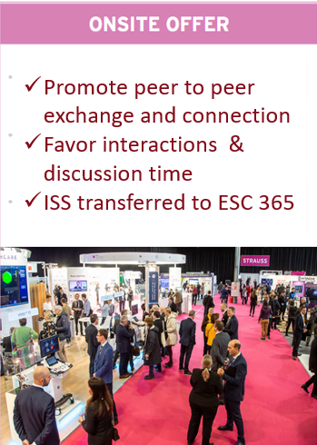
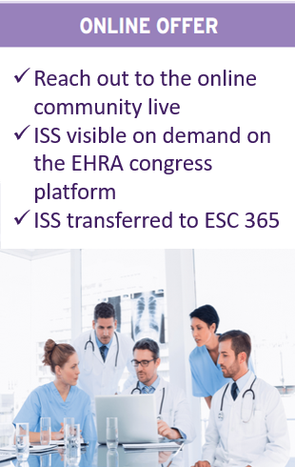
Industry Sponsored Session

Slide 26
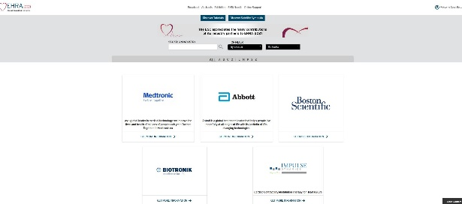
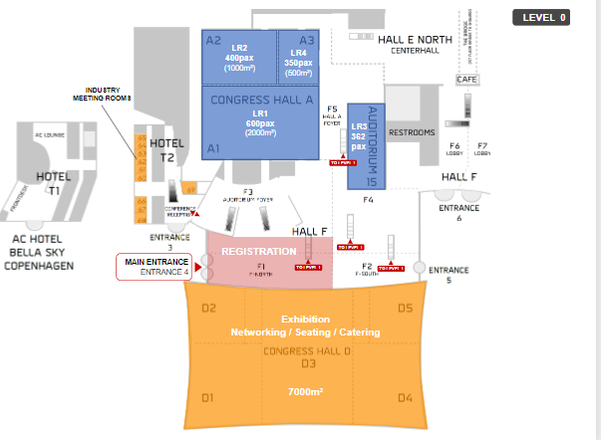
Exhibition (on site)
Booth onsite
Exhibition (on line)
Dedicated page
Logo
URL of your choice

Slide 27
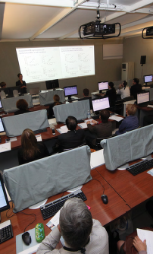
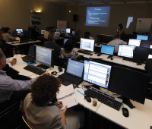
Tutorials
Formats & audiences
ONSITE Delegates present in Copenhagen | Dedicated rooms for hands-on and training of products/therapies Demonstration of equipment. Small groups. Reserved for 3 days Part of the scientific programme Rooms are equipped to allow online registration (only for onsite/online)
ONSITE & ONLINE (Online Dedicated Exhibitor Page required for this format) Delegates present in Copenhagen and/or registered for the online format

Slide 28
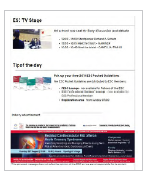


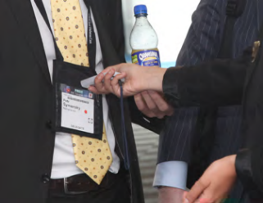

Onsite Partner Services
Sponsorship
Various opportunities to promote your activities onsite & online
Meeting Rooms
Organise informal meetings
Host a limited number of guests
Reserved for 3 days
Closed Industry Meetings
During available time slots
Staff briefing or specific closed meetings

Slide 29
Key dates
Mid October
Industry Prospectus
17 November 2021
EHRA 2022 Accrued Point Ranking Deadline
2 December 2021
Assignment starts
APR + Onsite/Online format
3 February 2022
Submission to French Competent Authority (ARS) Deadline

Slide 30


